Slide 1

WHAT ARE THE ODDS FOR WHISTLEBLOWERS?
Osha/dwpp research & analysis

Slide 2
What is dwpp? Directorate of Whistleblower Protection Programs
The Occupational Safety and Health Administration’s (OSHA) Directorate of Whistleblower Protection Programs (DWPP) operates under the United States Department of Labor.
The data for this project was first found at https://www.whistleblowers.gov/factsheets_page/statistics and related links in the Resources menu.
Excel was used to extract data from .pdf’s and to scrape data from the embedded charts on the related links to create .csv files.
These files are viewable at: https://github.com/TLeahSpencer/DWPP_Analysis/tree/master/DWPP%20CSVs
Notes:
This is a government agency which is intended to protect whistleblowers. However they find “merit” in the complaint approximately 1% of the time.

Slide 3
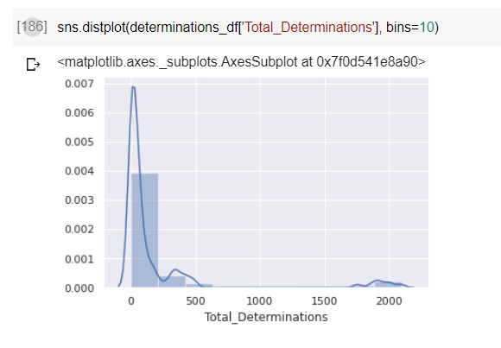
Variables varied… No normal distributions could be found
Notes:
This is the distribution of total determinations. The distribution for all outcomes can be found individually in the notebook for this project at https://colab.research.google.com/drive/18ijg41cIVYjaW23lNBmgpM8IsyzQoN1-?usp=sharing

Slide 4
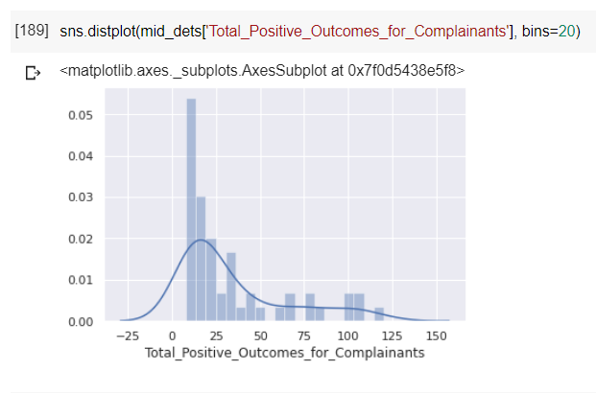
Outliers out! Still… No normal distributions
Notes:
The oulier removal was accomplished by removing the Statute OSHA, which had around 2000 cases per year. All other statutes were 500 or less.
Also removed were the Statues that had less than 40 cases per year.

Slide 5
How & what to compare?
Without Normal Distribution, no t tests were possible
Some comparisons were still made:
TOTAL POSITIVE AND NEGATIVE OUTCOMES FOR COMPLAINANTS
OUTCOMES UNDER THE YEARS OF PRESIDENTS FROM DIFFERENT POLITICAL PARTIES

Slide 6
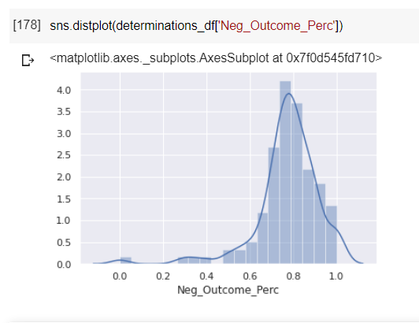
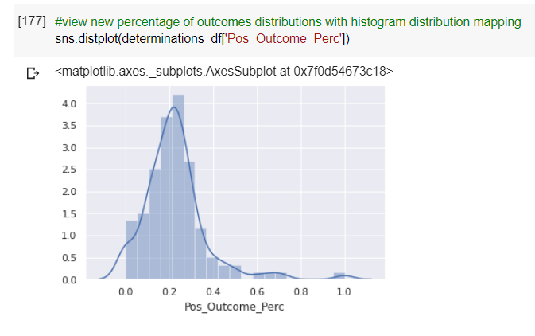
80% negative 20% positive
Notes:
The odds are not good for a positive outcome.

Slide 7
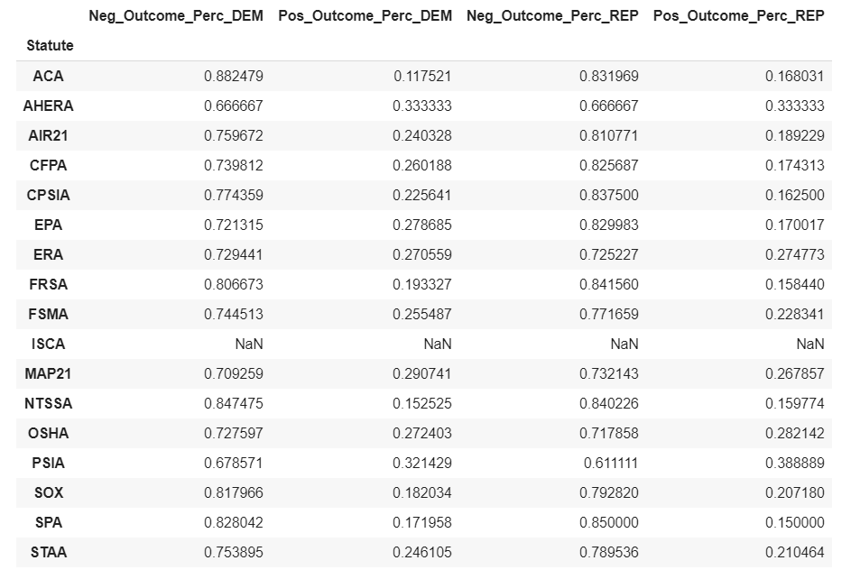
Republican vs democratic presidential years
Democratic: 9 statutes with higher positive outcome rates averaging a little under 5% each, for a total of 43% more positive outcomes.
Republican: produced 6 statutes with higher positive outcome rates, averaging a little over 5% each, for a total of 16% more positive outcomes.
Notes:
The odds are not good for a positive outcome.

Slide 8
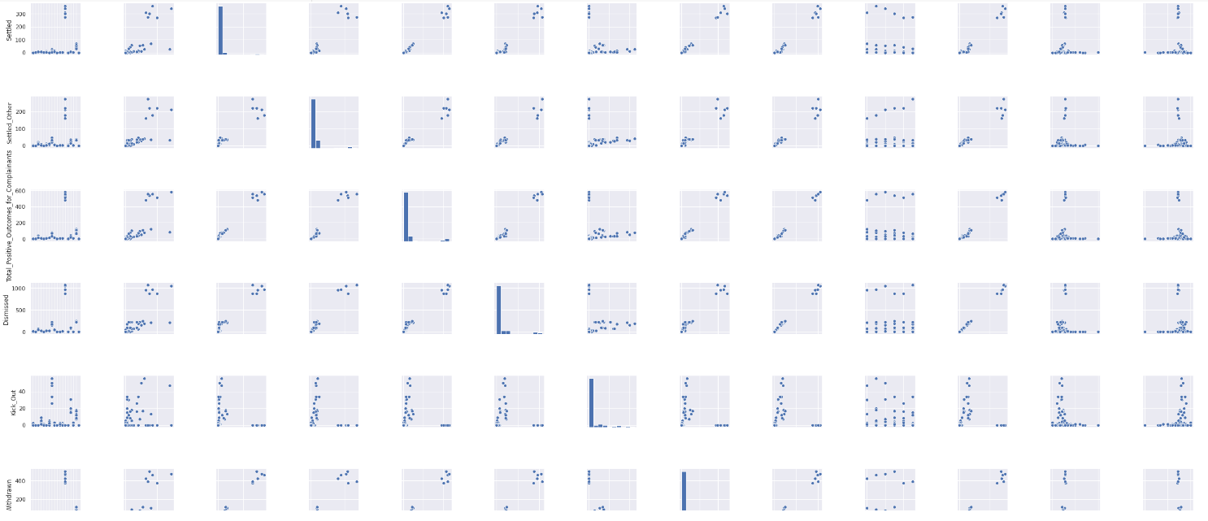
TO CORRELATE…. OR NOT?

Slide 9
iterations
Bar charts for the results of comparisons
Additional groups to compare
Regulation requirements
Partnering Agencies

Slide 10
Thank you for your time!

